Slide 1
Clinical Notes + EHR Update
Mitesh Jalan

Slide 2
2/19/24
Applied for MIMIC-III/IV dataset access on physionet.org
Went through Research papers:
Lyu, W., Dong, X., Wong, R., Zheng, S., Abell-Hart, K., Wang, F., & Chen, C. (2023). A Multimodal Transformer: Fusing Clinical Notes with Structured EHR Data for Interpretable In-Hospital Mortality Prediction. AMIA Annu Symp Proc. 2023 Apr 29;2022:719-728. PMID: 37128451; PMCID: PMC10148371.

Slide 3
Summary
Use Clinical BERT (Fined-tuned on MIMIC-III) for generation of Input embeddings.
Using Multimodal embedding (3 encoders in transformer block were used: One for each clinical notes and EHR(structured data) , finally one for concatenation of both the previous encoders.
The final output from Multimodal Encoder (48 encodings for 48 hours) is passed to transformer layer and the output form the transformer let’s say TMM concatenated to the clinical note embedding to generate a prediction(Binary output[Risk of Mortality]).

Slide 4
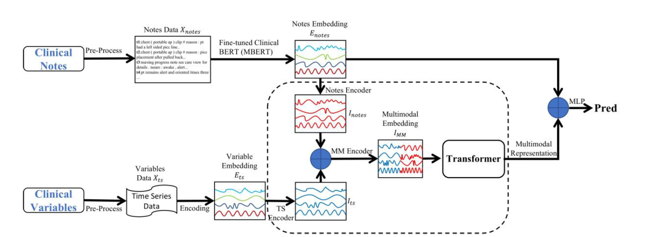
Architecture
Lyu W, Dong X, Wong R, Zheng S, Abell-Hart K, Wang F, Chen C. A Multimodal Transformer: Fusing Clinical Notes with Structured EHR Data for Interpretable In-Hospital Mortality Prediction. AMIA Annu Symp Proc. 2023 Apr 29;2022:719-728. PMID: 37128451; PMCID: PMC10148371.

